Slide 1
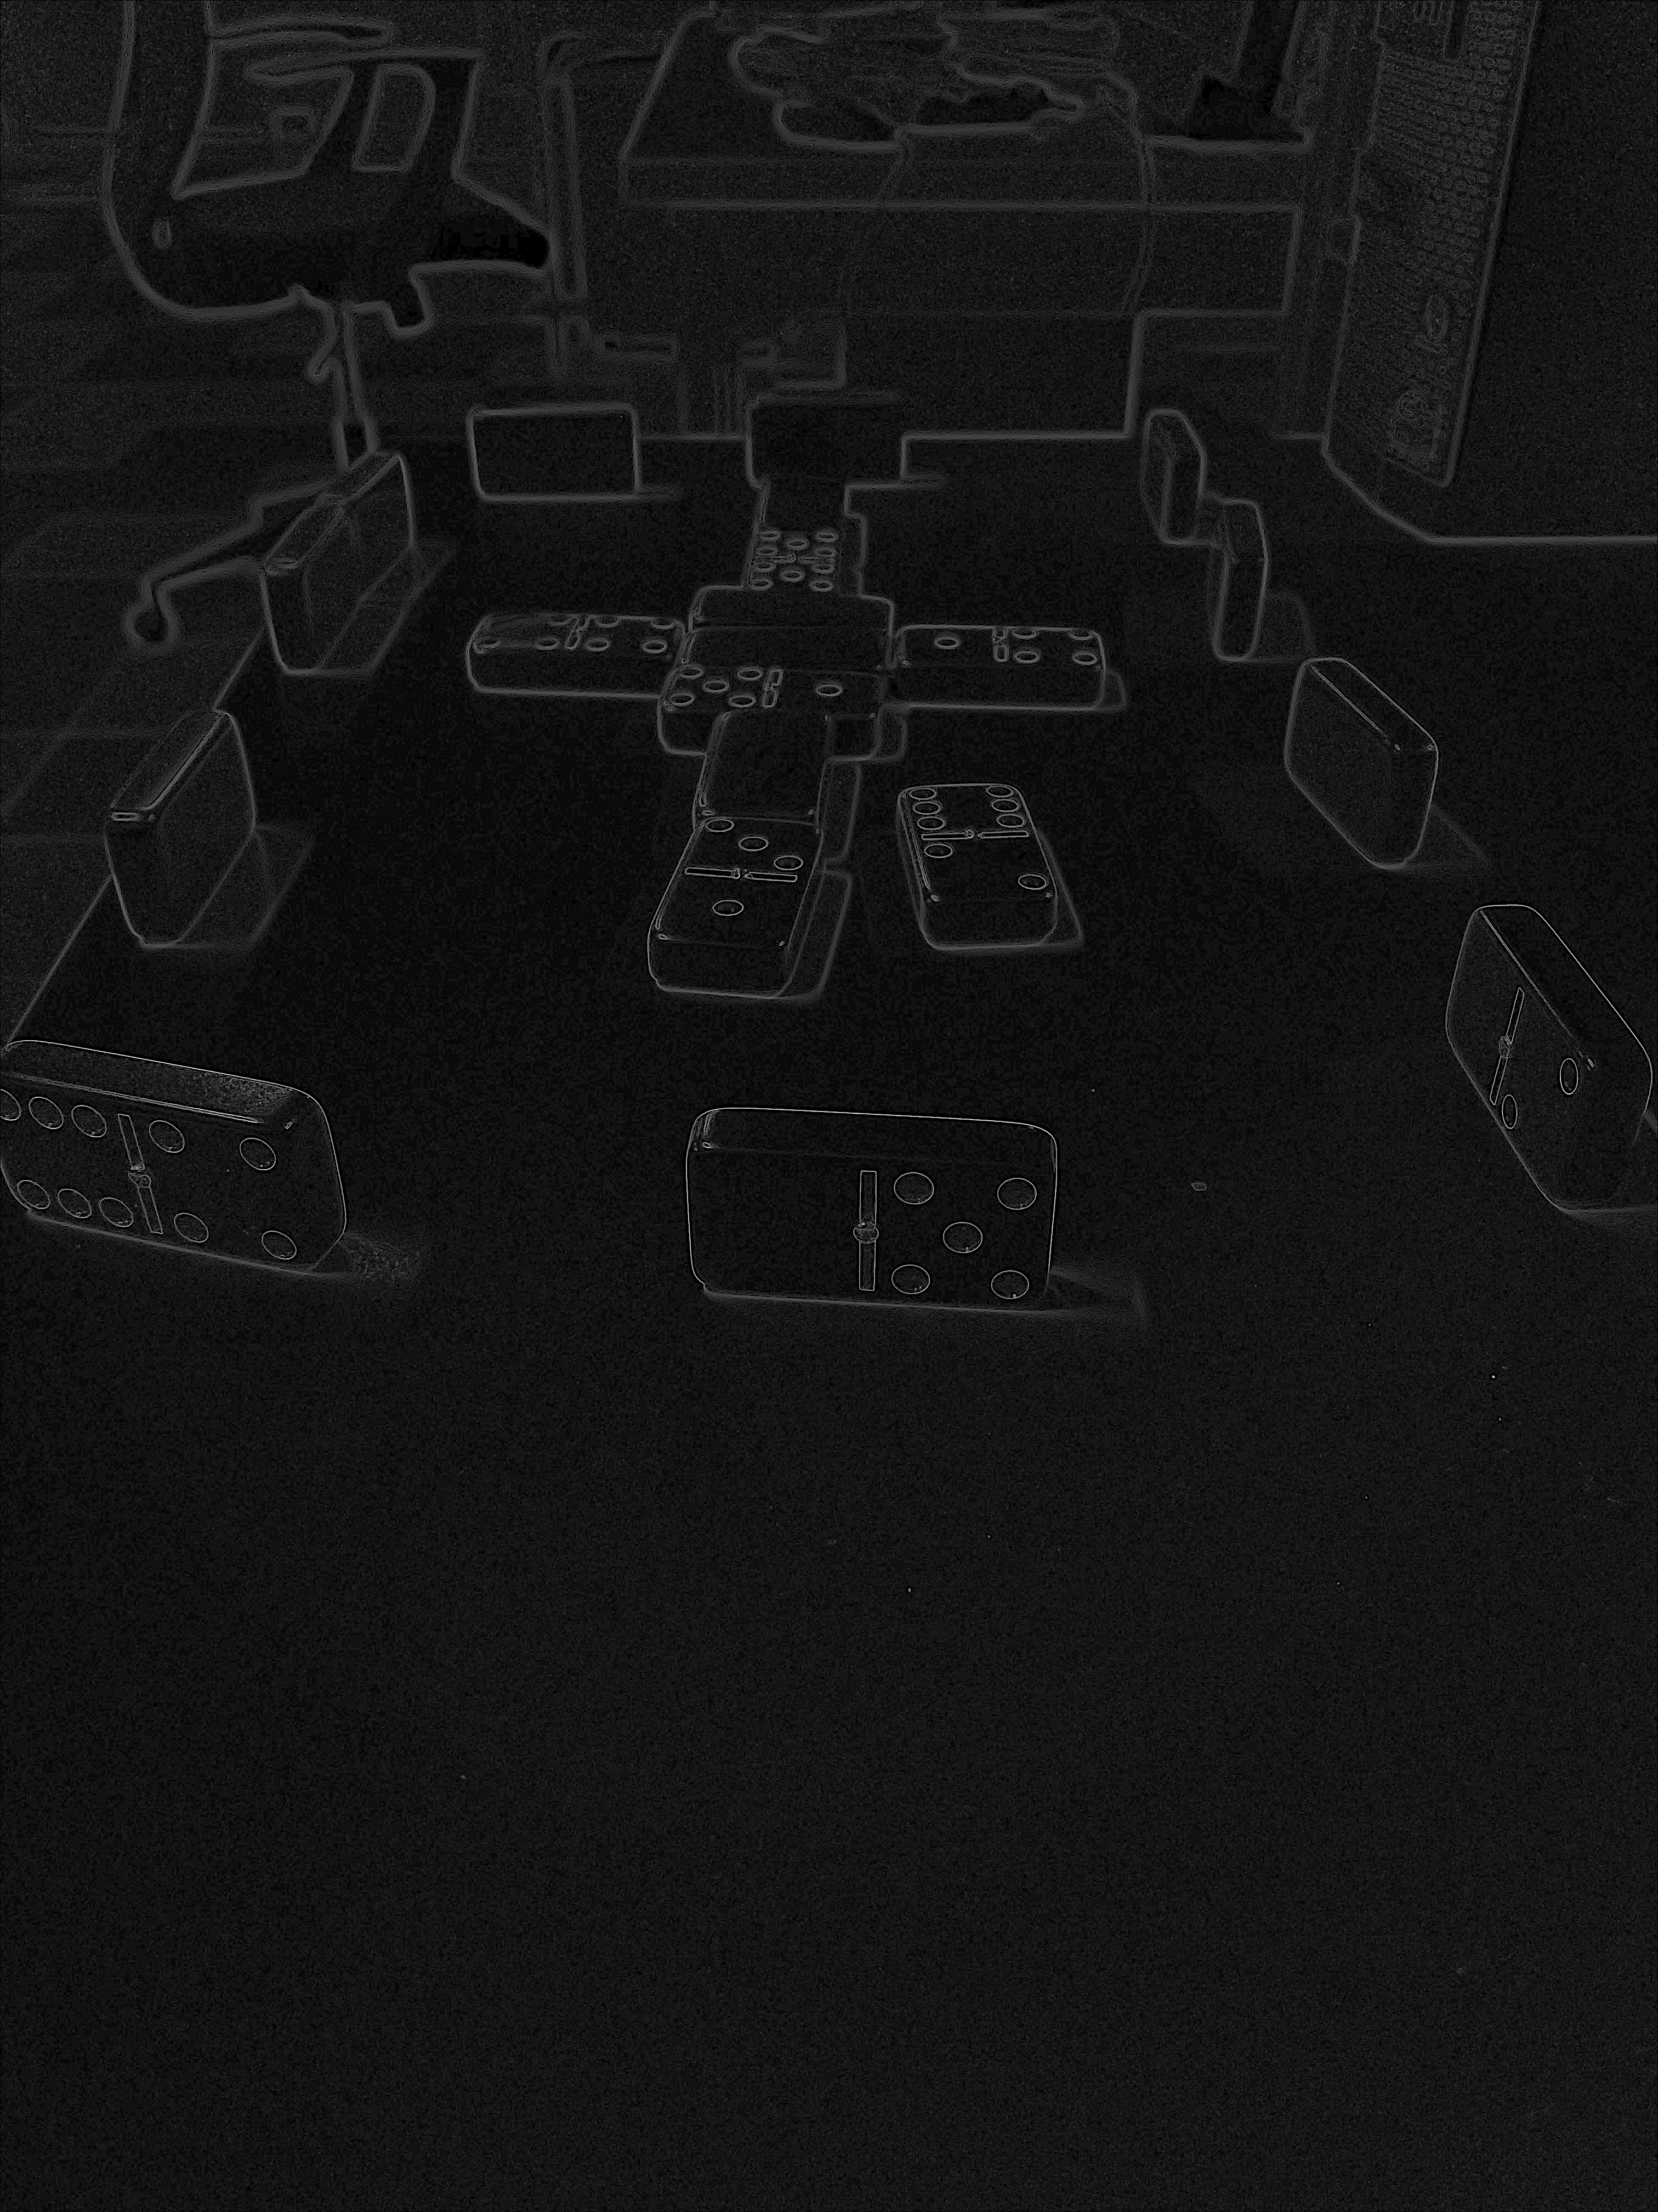
Function: Edge Detection and Convolution

